Slide 1
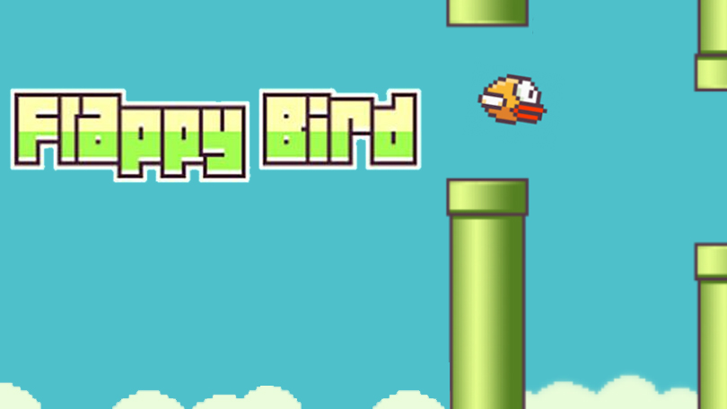

Slide 2
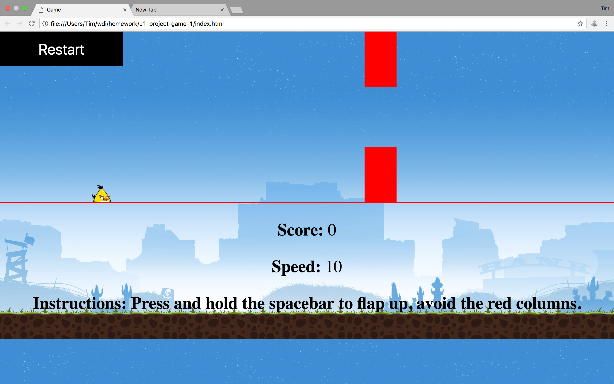

Slide 3
Challenges
Getting the scoreboard to increment by 1 every time the bird passes the columns.
Getting the columns to reappear with random heights
Staying organized and focus on one code at a time
Creating an end game

Slide 4
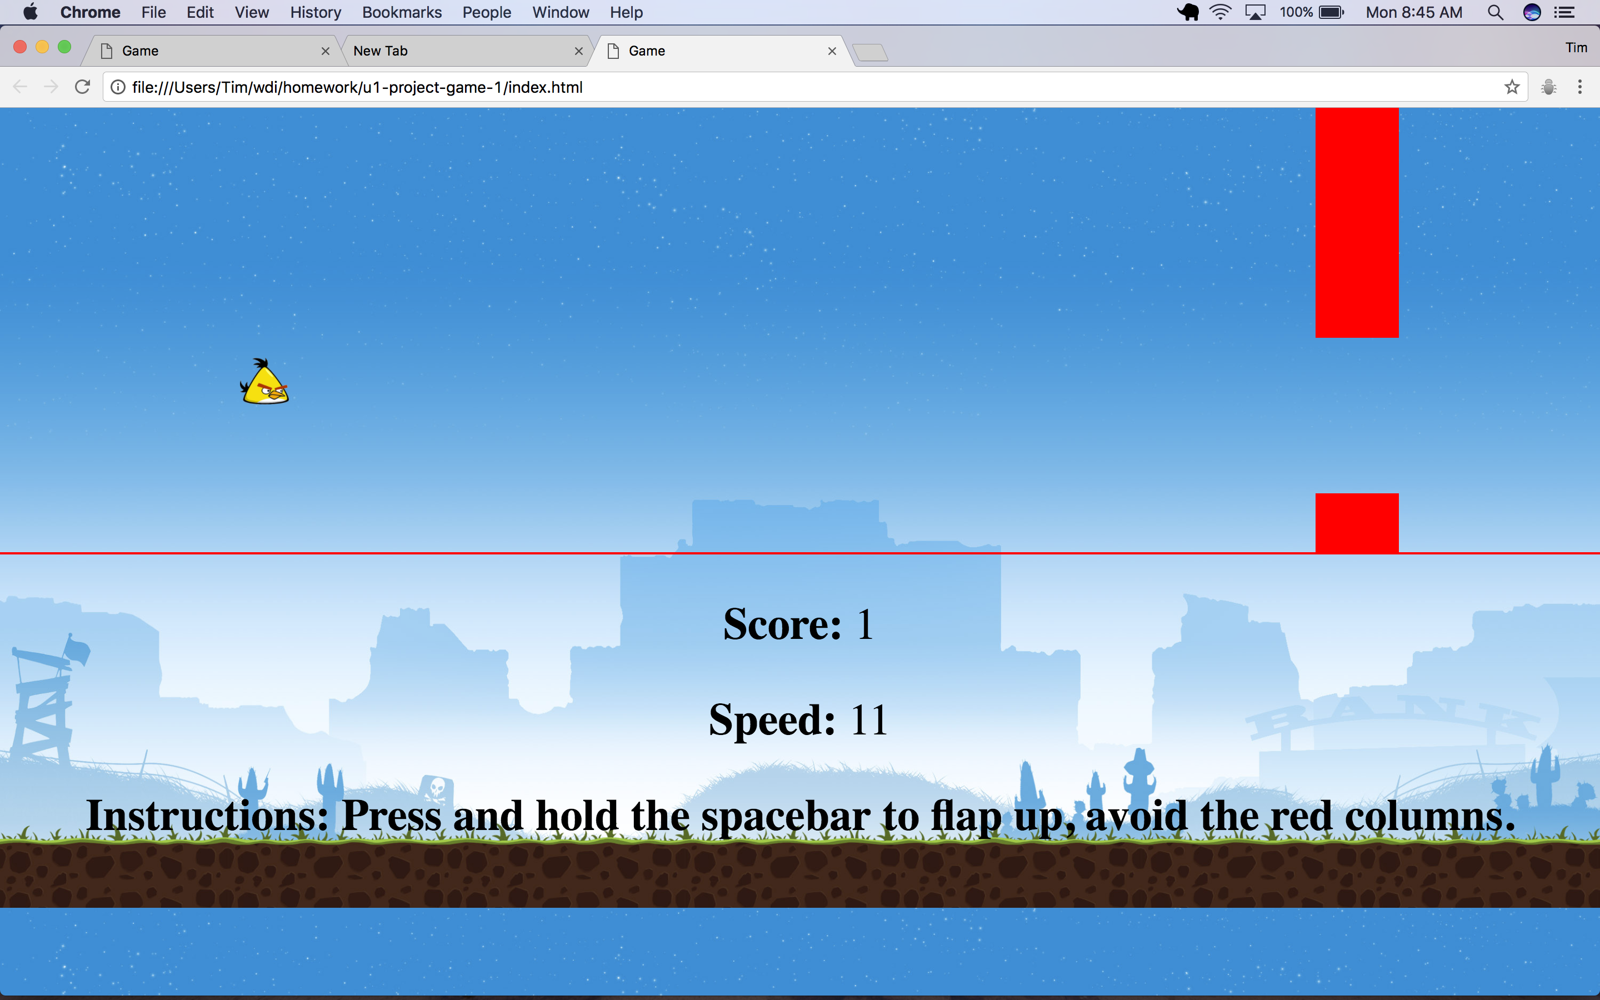

Slide 5
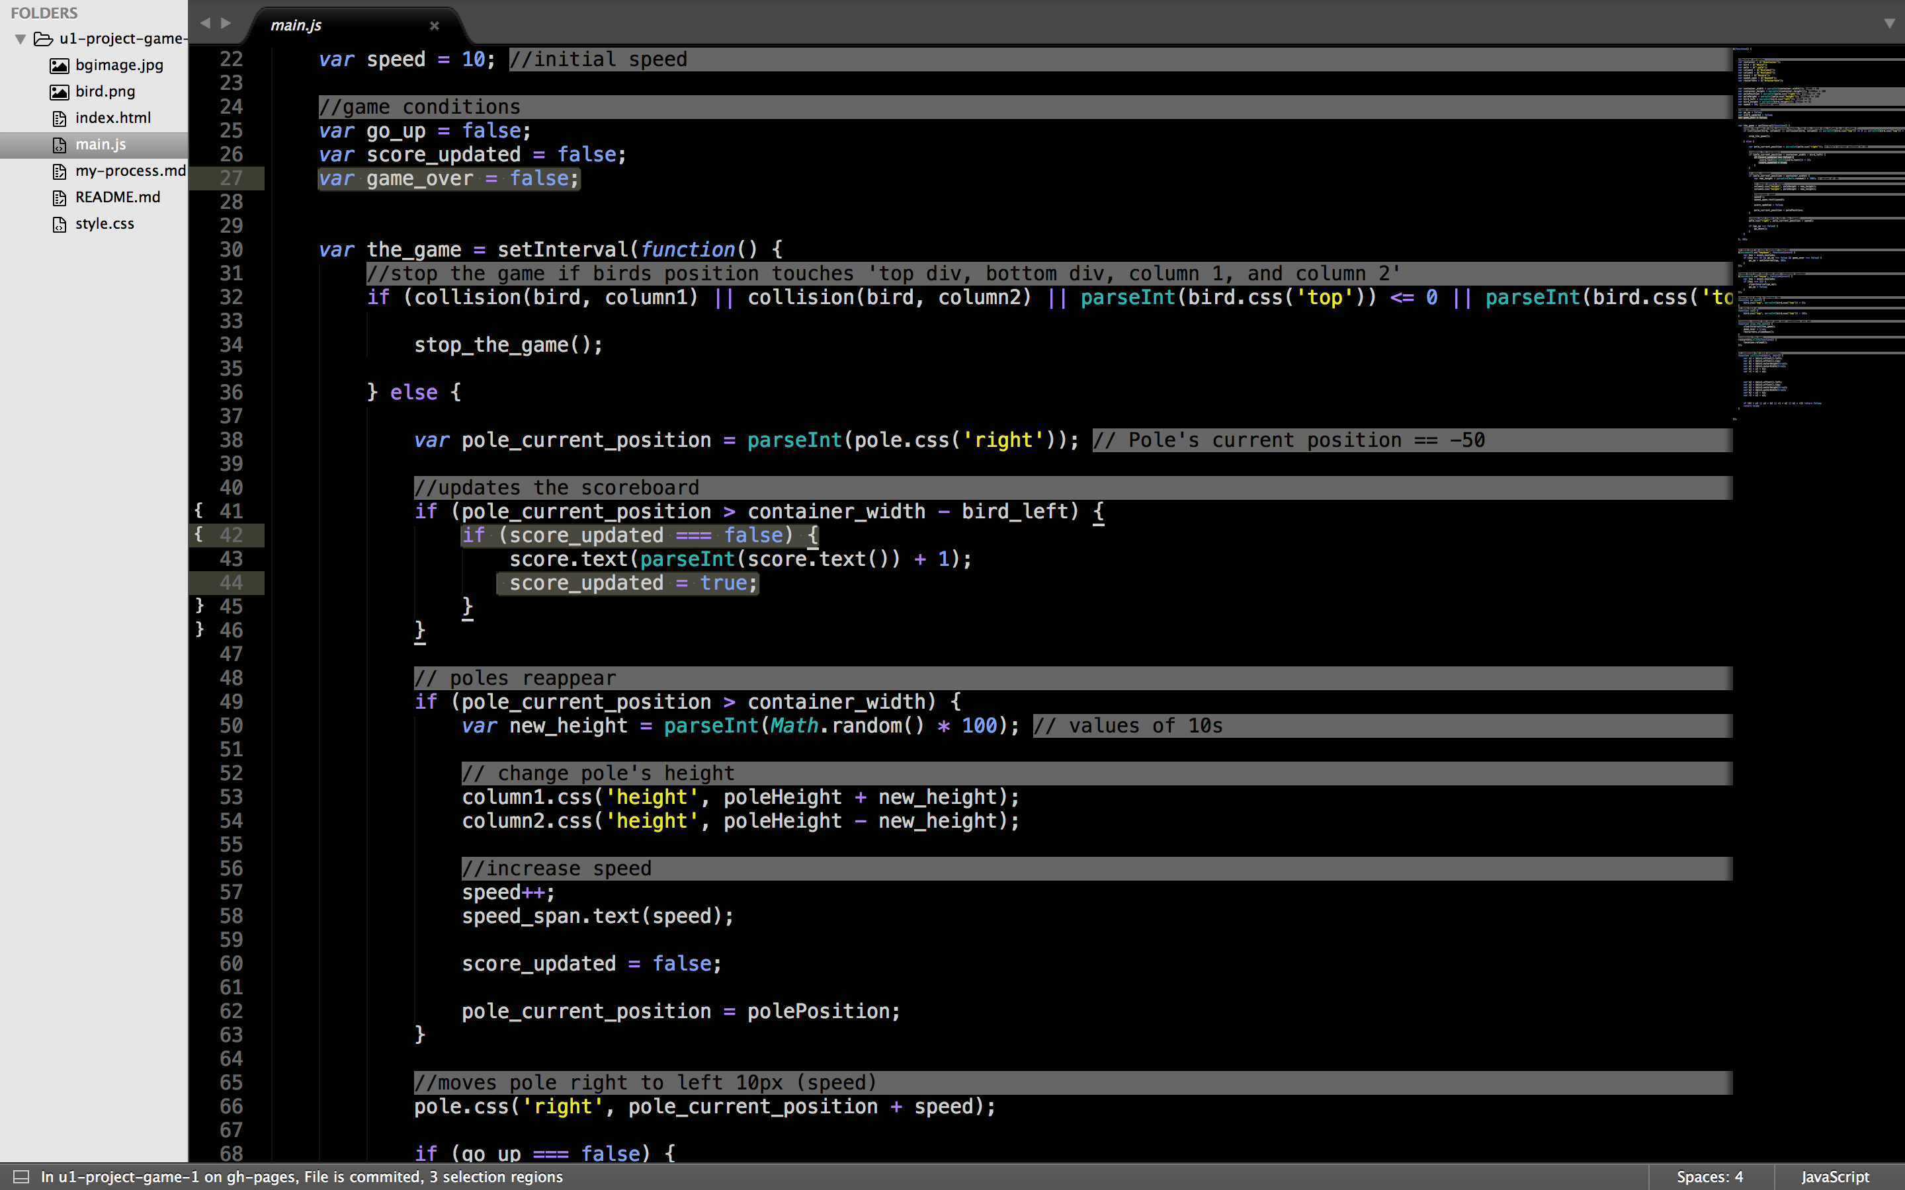

Slide 6
Success
Being able to move the columns
Styling
Increasing speed every interval

Slide 7
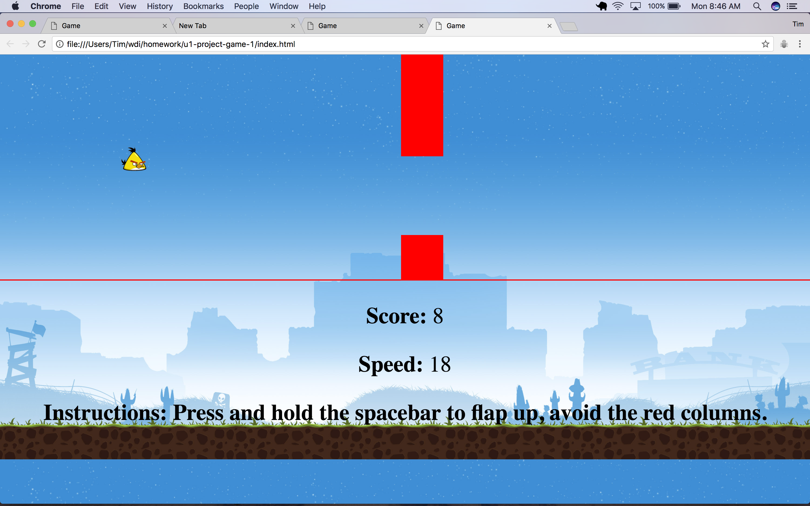

Slide 8
keyDown and keyUp
Making the bird float
Using inspector tools, I found the key code for the space bar (32)
keyDown pushes the bird down
keyUp pushes the bird up

Slide 9
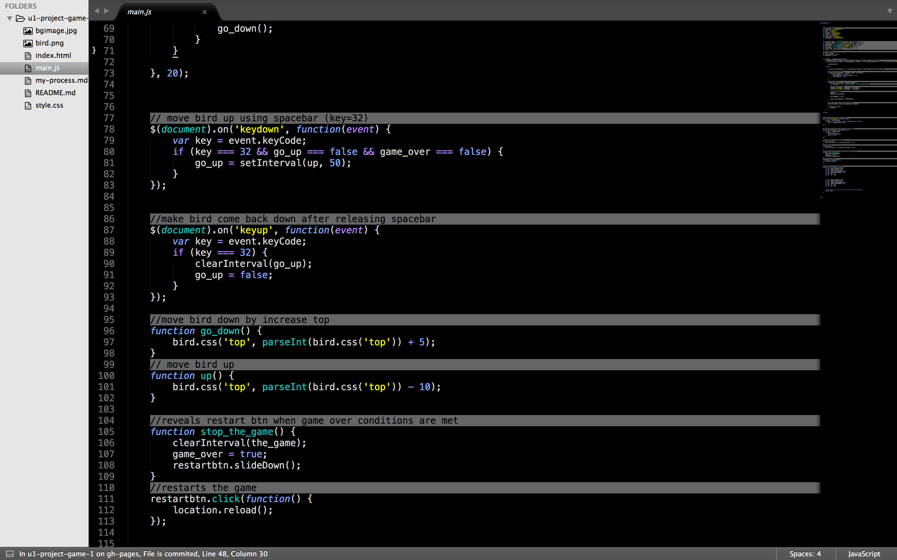

Slide 10
1 More Week
Create a home page to activate start
Create a typing game to remove the columns instead of pressing spacebar
Track user’s high score

